Slide 1
Advanced Data Science Capstone Project: Prediction of cardiovascular events.
Prepared by: Maxim Lukin
As of date: 2/10/2020

Slide 2
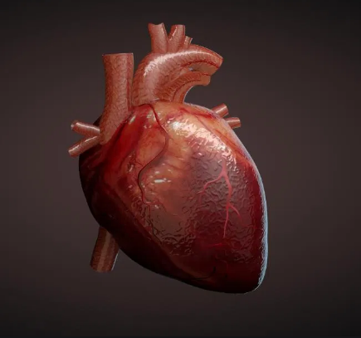
Use Case:
Cardiovascular diseases (CVDs) are the number 1 cause of death globally, taking an estimated 17.9 million lives each year *.
Data Set:
For current case study Heart Disease Data Set has been chosen **.
Data Set Creators:
1. Hungarian Institute of Cardiology. Budapest: Andras Janosi, M.D.
2. University Hospital, Zurich, Switzerland: William Steinbrunn, M.D.
3. University Hospital, Basel, Switzerland: Matthias Pfisterer, M.D.
4. V.A. Medical Center, Long Beach and Cleveland Clinic Foundation: Robert Detrano, M.D., Ph.D.
* https://www.who.int/health-topics/cardiovascular-diseases/#tab=tab_1
** https://www.kaggle.com/ronitf/heart-disease-uci

Slide 3



Libraries and Versions:
Python: 3.6.9 |Anaconda, Inc.| (default, Jul 30 2019, 19:07:31)
[GCC 7.3.0]
Pandas: 0.25.3
Numpy: 1.15.4
Sklearn: 0.20.3
Matplotlib: 3.1.3
Keras: 2.2.4

Slide 4
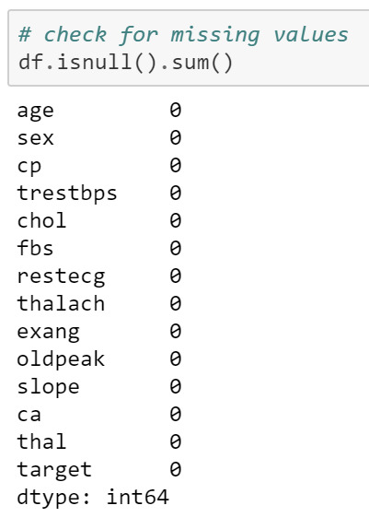
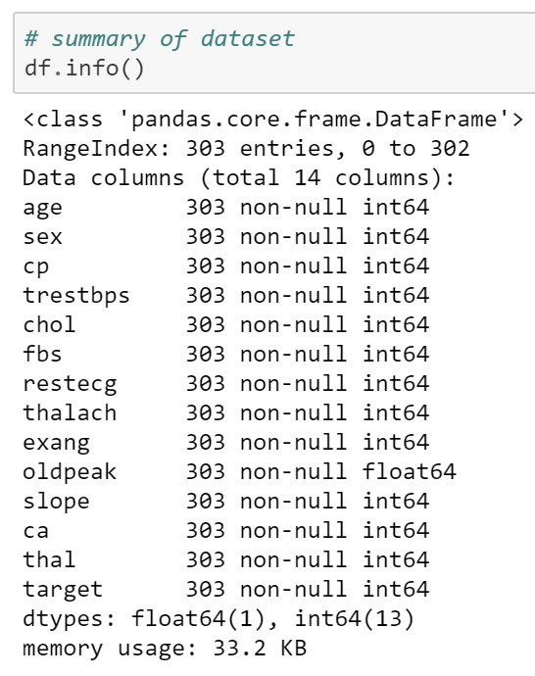
Data Quality Assessment:
Heart Disease Data Set from Kaggle has been initially available as a cleansed and transformed/adopted data set.
During ETL process dataset has been checked once again for any possible missing values in data frame and inappropriate attributes formats.
Data Attribute Information:
age {age}
sex (1 = male; 0 = female) {sex}
chest pain type (4 values) {cp}
resting blood pressure {trestbps}
serum cholestoral in mg/dl {chol}
fasting blood sugar > 120 mg/dl (1 = true; 0 = false) {fbs}
resting electrocardiographic results (values 0,1,2) {restecg}
maximum heart rate achieved {thalach}
exercise induced angina {exang}
oldpeak = ST depression induced by exercise relative to rest {oldpeak}
the slope of the peak exercise ST segment {slope}
number of major vessels (0-3) colored by flourosopy {ca}
thal: 3 = normal; 6 = fixed defect; 7 = reversable defect {thal}

Slide 5
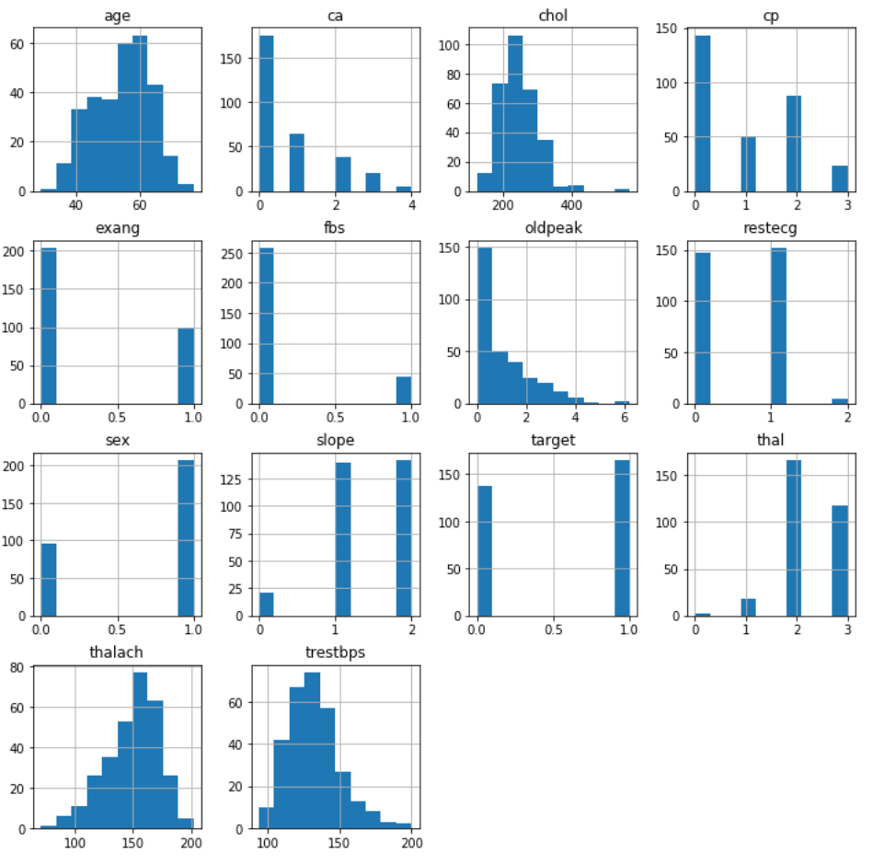
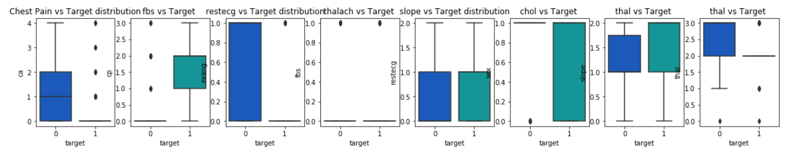
Data Visualization
Data Attribute Information:
age {age}
sex (1 = male; 0 = female) {sex}
chest pain type (4 values) {cp}
resting blood pressure {trestbps}
serum cholestoral in mg/dl {chol}
fasting blood sugar > 120 mg/dl (1 = true; 0 = false) {fbs}
resting electrocardiographic results (values 0,1,2) {restecg}
maximum heart rate achieved {thalach}
exercise induced angina {exang}
oldpeak = ST depression induced by exercise relative to rest {oldpeak}
the slope of the peak exercise ST segment {slope}
number of major vessels (0-3) colored by flourosopy {ca}
thal: 3 = normal; 6 = fixed defect; 7 = reversable defect {thal}

Slide 6
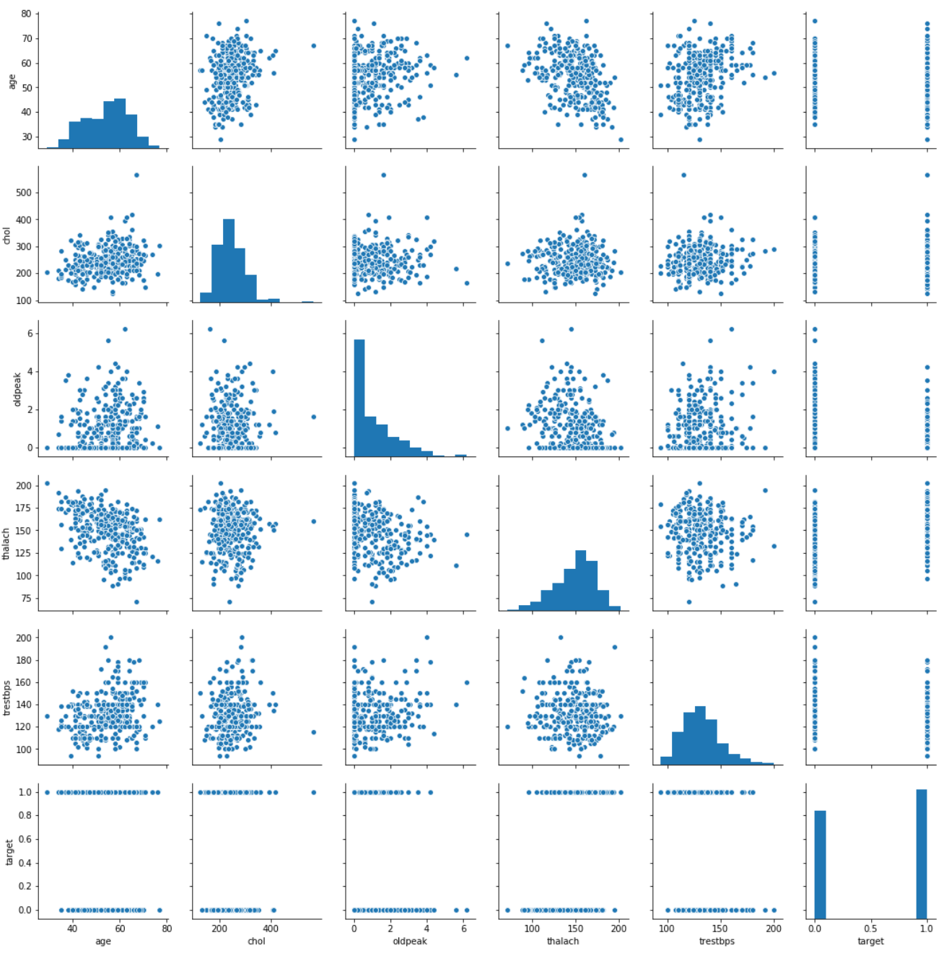
Data Visualization
Data Attribute Information:
age {age}
sex (1 = male; 0 = female) {sex}
chest pain type (4 values) {cp}
resting blood pressure {trestbps}
serum cholestoral in mg/dl {chol}
fasting blood sugar > 120 mg/dl (1 = true; 0 = false) {fbs}
resting electrocardiographic results (values 0,1,2) {restecg}
maximum heart rate achieved {thalach}
exercise induced angina {exang}
oldpeak = ST depression induced by exercise relative to rest {oldpeak}
the slope of the peak exercise ST segment {slope}
number of major vessels (0-3) colored by flourosopy {ca}
thal: 3 = normal; 6 = fixed defect; 7 = reversable defect {thal}

Slide 7
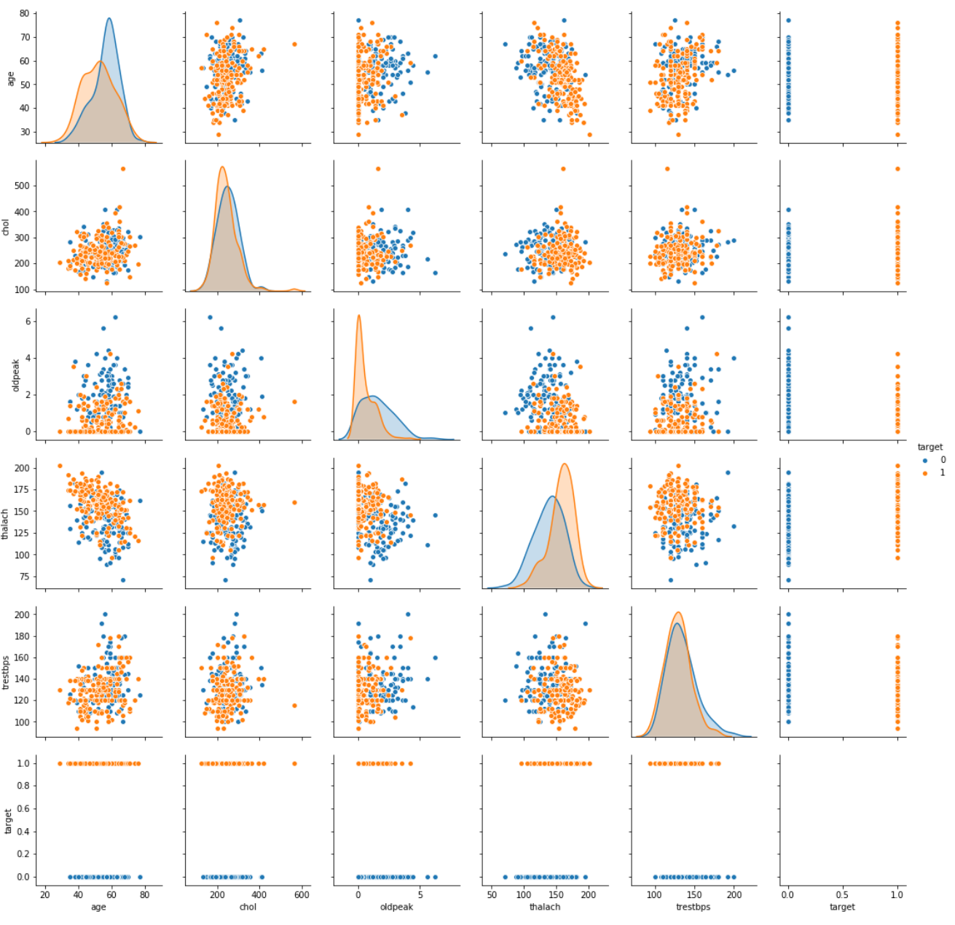
Data Visualization
Data Attribute Information:
age {age}
sex (1 = male; 0 = female) {sex}
chest pain type (4 values) {cp}
resting blood pressure {trestbps}
serum cholestoral in mg/dl {chol}
fasting blood sugar > 120 mg/dl (1 = true; 0 = false) {fbs}
resting electrocardiographic results (values 0,1,2) {restecg}
maximum heart rate achieved {thalach}
exercise induced angina {exang}
oldpeak = ST depression induced by exercise relative to rest {oldpeak}
the slope of the peak exercise ST segment {slope}
number of major vessels (0-3) colored by flourosopy {ca}
thal: 3 = normal; 6 = fixed defect; 7 = reversable defect {thal}

Slide 8
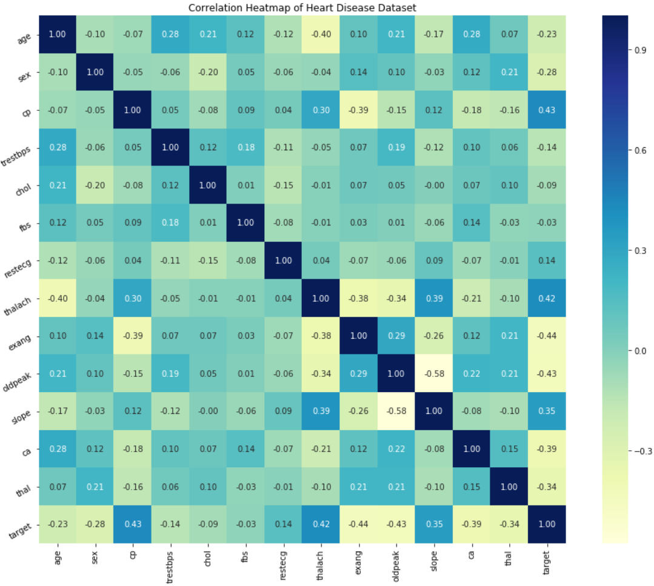
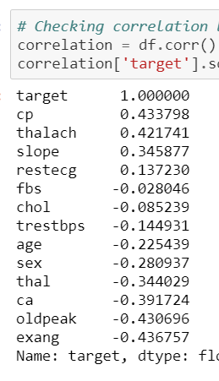
Data Visualization
Data Attribute Information:
age {age}
sex (1 = male; 0 = female) {sex}
chest pain type (4 values) {cp}
resting blood pressure {trestbps}
serum cholestoral in mg/dl {chol}
fasting blood sugar > 120 mg/dl (1 = true; 0 = false) {fbs}
resting electrocardiographic results (values 0,1,2) {restecg}
maximum heart rate achieved {thalach}
exercise induced angina {exang}
oldpeak = ST depression induced by exercise relative to rest {oldpeak}
the slope of the peak exercise ST segment {slope}
number of major vessels (0-3) colored by flourosopy {ca}
thal: 3 = normal; 6 = fixed defect; 7 = reversable defect {thal}

Slide 9
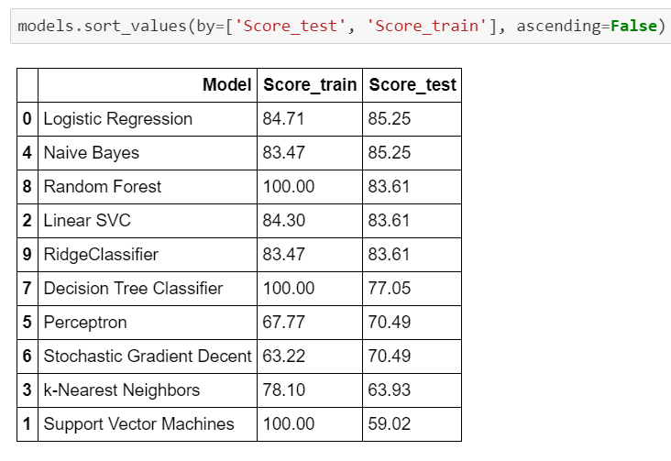
Training and testing models and algorithms
Based on the capstone project requirements and for educational purposes the following algorithms have been used:
Logistic Regression,
Support Vector Machines,
Linear Support Vector Machines (SVC),
k-Nearest Neighbors algorithm (KNN),
Gaussian Naive Bayes,
Perceptron,
Stochastic Gradient Descent,
Decision Tree Classifier,
Random Forest,
Ridge Classifier.
https://eu-gb.dataplatform.cloud.ibm.com/analytics/notebooks/v2/4c28ac5d-30c8-4029-85c6-bebfc22418ec/view?projectid=535fa780-2008-4612-9dad-6472967021c4&context=analytics

Slide 10
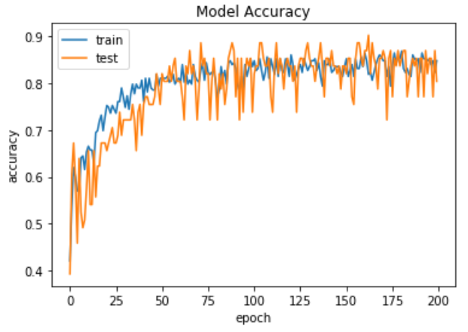
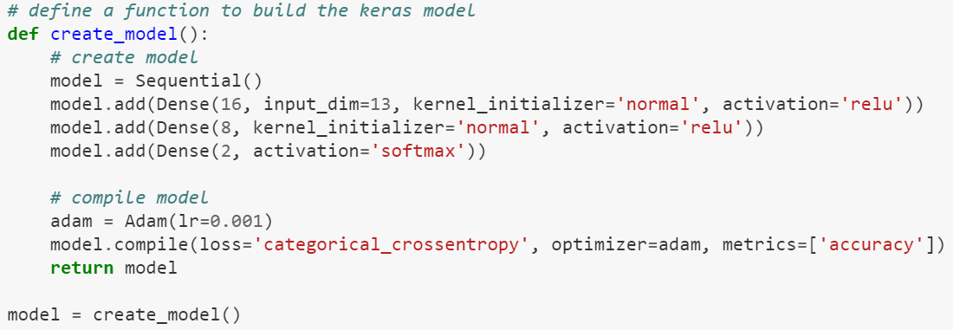
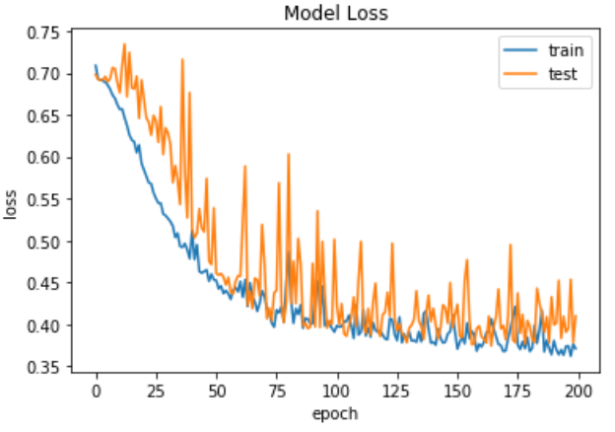
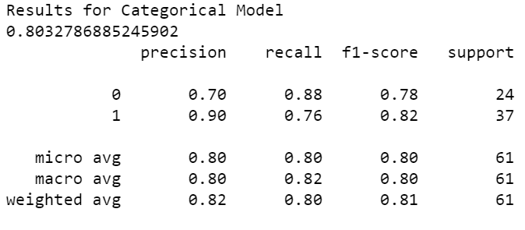
Keras Neural Network

Slide 11
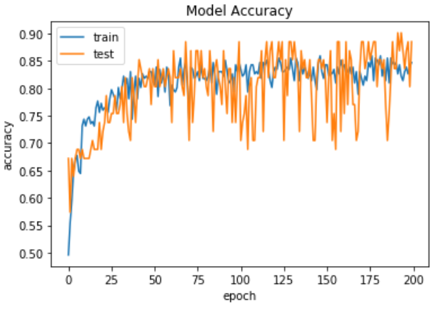
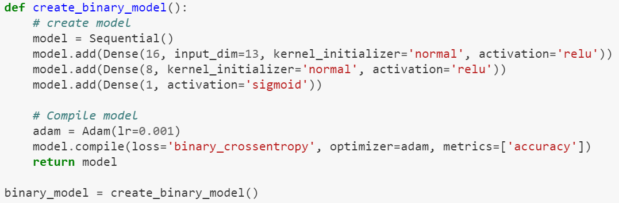
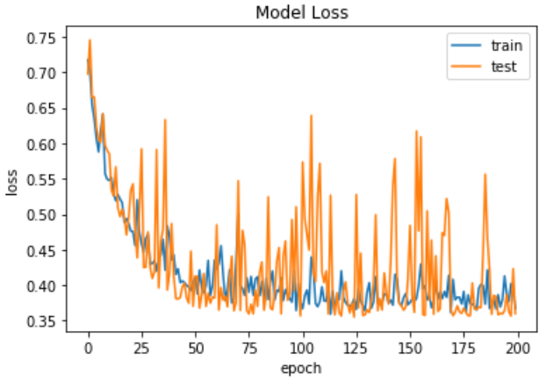
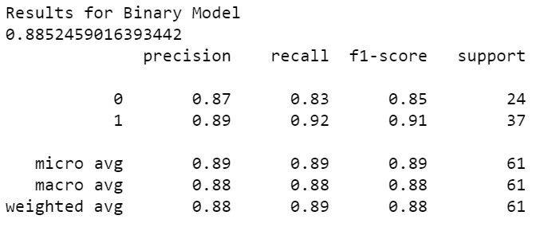
Keras Neural Network (one more iteration):
Loss: categorical => binary
Output layer: softmax => sigmoid

Slide 12
THANK YOU FOR YOUR TIME ! ! !
Postscript:
That paper has been created based on the studies of the following contributors and data scientists:
https://www.kaggle.com/prashant111/extensive-eda-visualization-with-python
https://www.kaggle.com/faressayah/heart-disease-eda-9-ml-algorithms-90
https://www.kaggle.com/tentotheminus9/what-causes-heart-disease-explaining-the-model#The-Model
https://www.kaggle.com/cdabakoglu/heart-disease-classifications-machine-learning
https://www.kaggle.com/vbmokin/heart-disease-comparison-of-20-models
https://www.kaggle.com/rahul197/heart-disease-classification-machine-learning
https://www.kaggle.com/mytymohan/heart-disease-eda-lr-dt-rf-gb-svm-dl
https://towardsdatascience.com/machine-learning-for-diabetes-562dd7df4d42
https://towardsdatascience.com/machine-learning-for-diabetes-562dd7df4d42
Thanks to everyone! Your work was very helpful for me!

